Slide 1
Project part 2
1. day - theory: change management, CB-analysis, deployment & training
Working with project part 2!
2. day - theory: security (Kasper)
Working with project part 2 including security issues
3. day – work on project (we are available for guidance)
4. day – work on project (we are available for guidance) and hand in!
Project part 2 – starts today
Hand in – 19. December

Slide 2
TODAY:
Resistance to change
Change theories
Cost-Benefit analysis
Deployment & training
Work on the project!

Slide 3
IT Systems can be a technical success but an organizational failure.

Slide 4
False Beliefs…
“People want this change.”
“Monday morning we’ll turn on the new system and they’ll use it.”
“A good training program will answer all of their questions and then they’ll love it.”
“Our people have been through a lot of change - what’s one more change going to matter?”
“They have two choices: they can change or they can leave.”

Slide 5
However, the results may be quite different…
The change may not occur.
People will comply for a time and then do things to get around the change.
Users will accept only a portion of the change.
The full benefits of the project are never realized or are realized only after a great deal of time and resources have been expended.

Slide 6
Signs of Resistance to Change
Active signs of resistance
Being critical
Finding fault
Ridiculing
Appealing to fear
Using facts selectively
Blaming or accusing
Sabotaging
Threatening
Manipulating
Undermining.
Starting rumors
Arguing
Passive signs of resistance
Agreeing verbally but not following through (“malicious compliance”)
Failing to implement change
Feigning ignorance
Withholding information, suggestions, help, or support
Standing by and allowing change to fail

Slide 7
Why Do People Resist Change?
Dislike of change
  People don’t resist change, they resist pain!
  Boredom can be pain, too.
Discomfort with uncertainty
  Low tolerance for ambiguity
Perceived negative effects of interests
  Authority, status, rewards, salary
Attachment to the established culture/ways of doing things
Perceived breach of psychological contract

Slide 8
Why Do People Resist Change?
Lack of conviction that change is needed
Lack of clarity as to what is needed
Belief that the specific change being proposed is inappropriate
Belief that the timing is wrong
Excessive change
Cumulative effects of other changes in one’s life
Reaction to the experience of previous changes
Disagreement with the way the change is being managed

Slide 9
Why do people support change?
Security
Money
Authority
Status/prestige
Responsibility
Better working conditions
Self-satisfaction
Less time and effort

Slide 10
Managing Resistance – The Situational Approach
The classic steps:
  Education and communication
  Participation and involvement
  Facilitation and support
  Negotiation and agreement
  Explicit and implicit coercion

Slide 11
The Resistance Cycle
Resistance is a natural (even necessary) psychological stage in any change:
  Denial / Shock
  Resistance / Anger
  Exploration / Mourning
  Commitment / Acceptance

Slide 12
Change Has an Impact
On Different Areas of the Organization
People
Structure
Technology
Task
Figure 11.4: Leavitt’s Model of Organizational Change

Slide 13


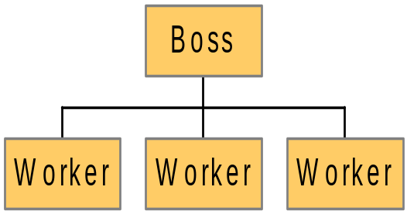

Leavitt’s Diamond:
Managing Organizational Change
Task
People
Structure
Technology

Slide 14
Lewin’s Three-Step Change Model
Unfreezing
Moving
Refreezing

Slide 15
Lewin’s Three-Step Model For Implementing Change
Unfreezing
  Change efforts to overcome the pressures of both individual resistance and group conformity.
Moving
  Efforts to get employees involved in the change process.
Refreezing
  Stabilizing a change intervention by balancing driving and restraining forces.

Slide 16

Just do it!

Slide 17
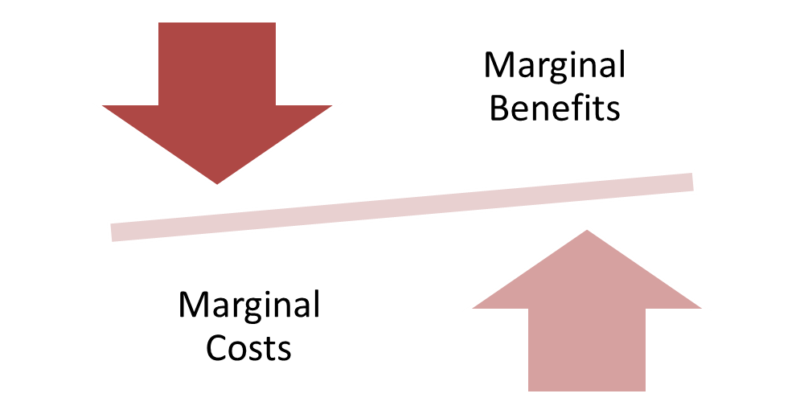
The Cost-Benefit Principle
Take an action if and only if the extra benefits are at least as great as the extra costs
Costs and benefits are not just money

Slide 18
Applying the Cost – Benefit Principle
Assume people are rational
  A rational person has well defined goals and tries to fulfill those goals as best they can
Would you walk to town to save $10 on an item?
  Benefits are clear
  Costs are harder to define

Slide 19

The Cost-Benefit Principle
COST
Tangible
Not Tangible
COST
BENEFIT
BENEFIT
Tangible
Not Tangible

Slide 20
Deployment-strategies
Definition:
Deployment (technical): installation and configuration of the IT functionality (eg a module or an entire system) in an environment so that end users can use it
Rollout in the organization: deployment of IT functionality in one or more departments so that it works in conjunction with the daily work processes. The rollout includes training of staff, changing working practices etc.

Slide 21
Deployment-strategies
Rollout
one department at a time
All departments
”A part of the system in all departments ” strategy
Part of the IT-system
”Traditionel” strategy
Deployment
”Full functionality in one department at a time” strategy
”Big Bang” strategy
The full IT-system

Slide 22
Deployment-strategies
There are several approaches to the implementation of IT systems:
Big Bang approach
The IT solution and all new working practices are implemented throughout the company in one major implementation
Phased approach
The IT solution and all new working practices are divided into smaller, incremental implementations.
Subsystem 1 -> Subsystem 2 -> Subsystem 3 ->the full system
Cluster approach
The full Solution to be gradually rolled out in subsidiaries / departments
Subsidiary B -> Subsidiary A -> Headquarters
Phased-cluster approach
Subsystem 1 in department A -> Subsystem 1 in department B -> Subsystem 2 in department A ->…………………………-> the full system in all departments

Slide 23
Choice of Deployment Strategy
What is possible?
- Is it possible to implement sub-systems?
- Is it possible or does it make sense to implement in parts of the organization?
- How big changes are required in business processes?
Sometimes big bang implementation is the only option!

Slide 24

TRAINING / EDUCATION
- Significant factor to anchor the system in the organization
- A rule of thumb: At least 20% of the cost of implementation should be used on education and training
Effect:
Users use the system as it is supposed to be used.
Less errors when used.
There is less wasted time.
Reduction of resistance to the changes that the IT system would cost.
Reduction of duration and "depth" of the effectiveness decreases in the company, which typically occur just after operation start.

Slide 25
TRAINING / EDUCATION
Opportunities.
- All employees
- Key Employees
- Super User Strategy
Clarify training needs
- Analysis of system
- Analysis of staff skills
Select Training Strategy
- Resources
- Time
- Employee time
- Organization time
- Staff
- Qualified intructors
Remember that training can be a ”change manage-ment activity”!

